Slide 1
Ch 6 – Arrays
CIS 142

Slide 2
Review from Chapter Five
Structured programming enables programmers to break complex systems into manageable components. Some reasons are:
Top-down design breaks the problem into small manageable components
Code reusability is implemented as functions in C
Information hiding is a process by which programmers conceal implementation details into functions.
Function prototypes tell C how your function will be built and used, normally found at the top of program.
float addTwoNumbers ( int, float )
Function definitions implement the function prototype. (The actual code)
Local variables are defined in functions, such as main() and lose their scope each time the function is executed
Global variables are created and defined outside any function.
Notes:
printf (line1\nline2\nline3\n”);

Slide 3
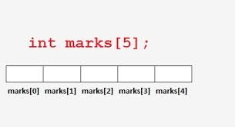
Arrays
Arrays are another common programming construct that be found in the highest levels of programming.
Arrays are a way of grouping “like variables” together.

Slide 4
Arrays
Variables in an array share the same name.
Variables in an array share the same data type.
Individual variables in an array are called elements
Elements in an array are accessed with an index number
Index numbers start with zero.

Slide 5
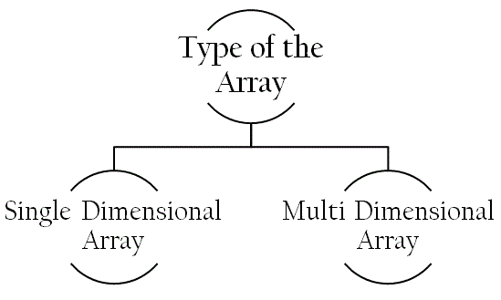
Arrays

Slide 6
ONe dimension ArrAy
Although there are no rules of when to use an array, some problems are better suited for an array based solution., like:
The # of pages in each chapter of a book
A List of students’ GPAs
A list of phone numbers
Your golf score history

Slide 7
Why use Arrays?
Let’s use the golf score example:
int hole1;
int hole2;
int hole3;
int hole4, hole5, hole6, hole7, hole8, hole9, hole10, hole11;
int hole12, hole13, hole14, hole15, hole16, hole17, hole18;
There are a lot of variables to keep track of. If we use an array, it would look like:
int golfScores[18];

Slide 8
Creating a single dimension array
Creating an array is simple, but it can take practice.
int golfScores [5];
This gives you 5 elements that can store intergers.
golfScores[0];
golfScores[1];
golfScores[2];
golfScores[3];
golfScores[4];

Slide 9
Creating a single dimension array
You can declare and initialize an array in the same line
int golfScores [5] = { 11, 22, 33, 44, 55};
This puts data in each element starting at .
golfScores[0] 11
golfScores[1] 22
golfScores[2] 33
golfScores[3] 44
golfScores[4] 55

Slide 10
Arrays
You can also initialize using a loop . . . Try it out. . . .

Slide 11
Arrays
\0 is another way of stating ‘Null’.
You can also initialize by:
char cName[ ] = { 'O', 'l', 'i', 'v', 'i', 'a', '\0' };
or
char cName[ ] = “Olivia”;

Slide 12
Searching ONE-Dimensional arrays
Using loops and conditional statements we can search through an array and find the value we are looking for.
Try it out. . . .
Element number | Value
Array[0] | 0
Array[1] | 2
Array[2] | 4
Array[3] | 6
Array[4] | 8

Slide 13
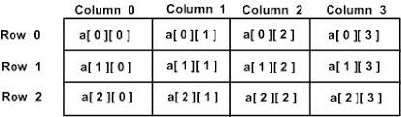
Two dimensional array

Slide 14
Two dimensional array
int TwoD [3] [3] = { { 0, 1, 2}, { 3, 4, 5}, { 6, 7, 8} };
TwoD [0][0] | TwoD [0][1] | TwoD [0][2]
TwoD [1][0] | TwoD [1][1] | TwoD [1][2]
TwoD [2][0] | TwoD [2][1] | TwoD [2][2]
0 | 1 | 2
3 | 4 | 5
6 | 7 | 8
=
TRY IT OUT. . . . .

Slide 15
Searching two-Dimensional arrays
Using loops and conditional statements we can search through an array and find the value we are looking for in a two dimensional array.
Try it out. . . . The end;

